Slide 1
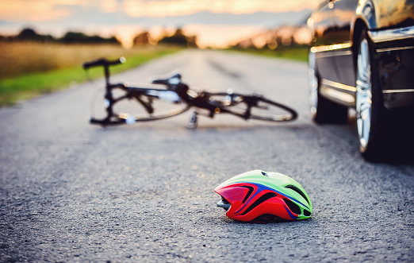

Cyclists involved in traffic crashes in Catalonia
Created by Joan Vendrell (February 2023)
Final Project – DA

Slide 2
OUR PROBLEM
Is it possible to minimize the crashes with cyclists?
Final Project – DA

Slide 3
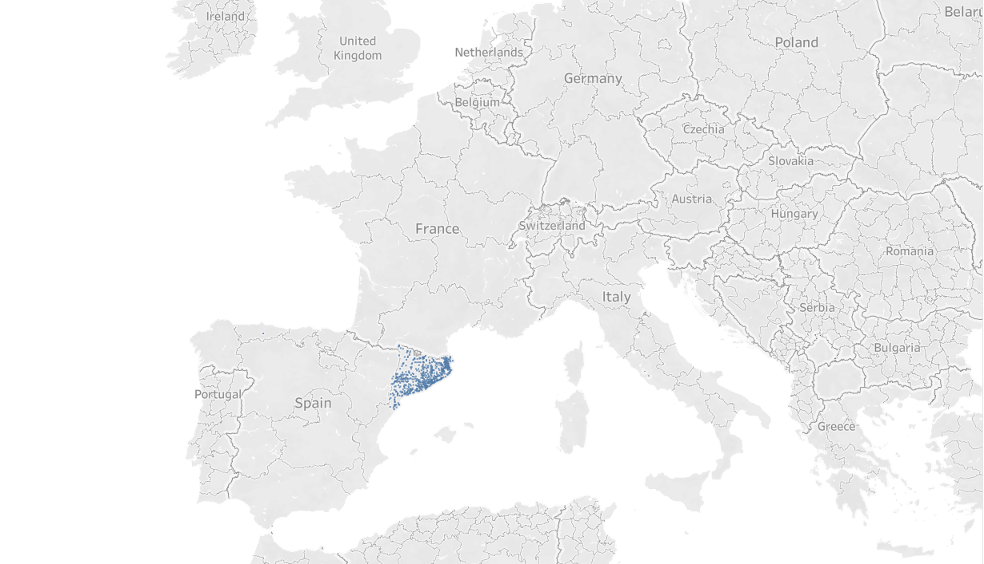
Final Project – DA

Slide 4
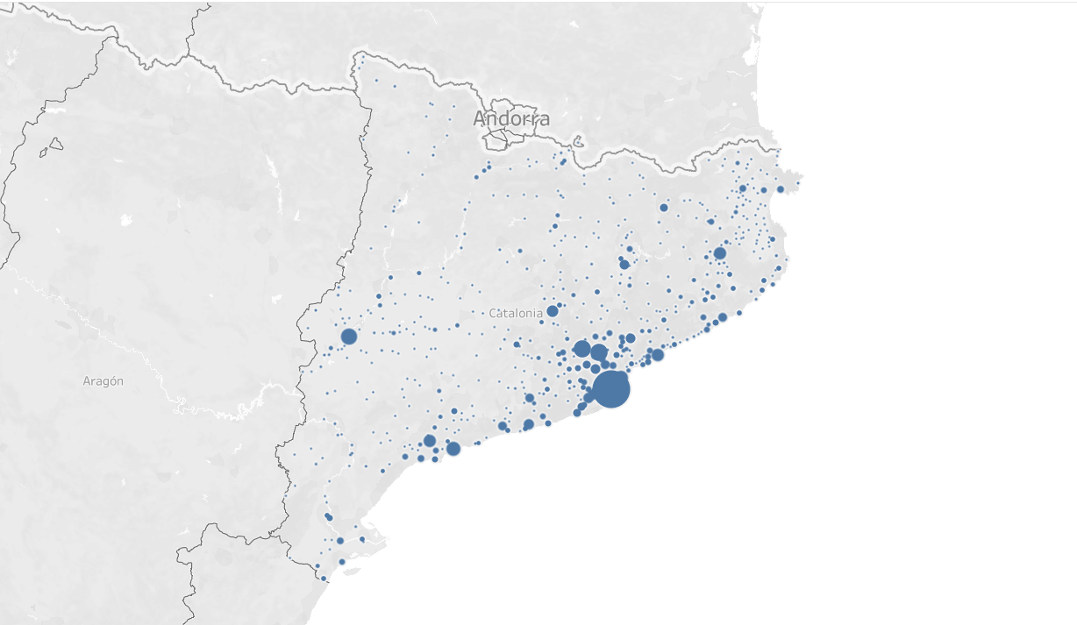
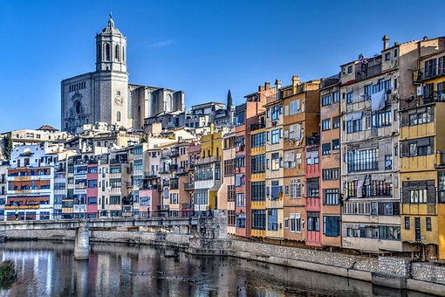
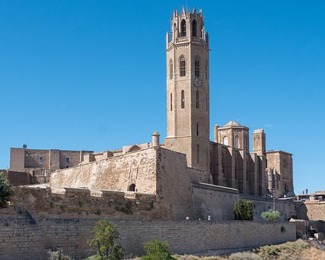

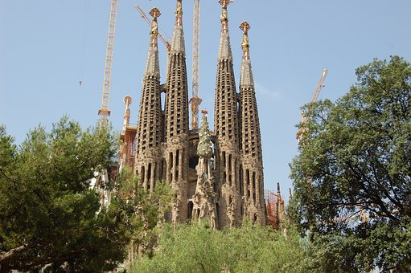
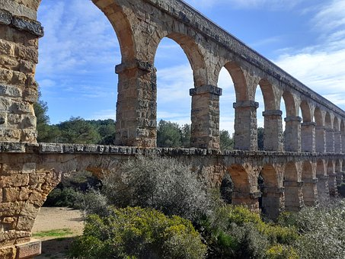
Girona
2 areas of crashes:
Lleida
On road
Urban zone
Barcelona
Tarragona
Final Project – DA

Slide 5

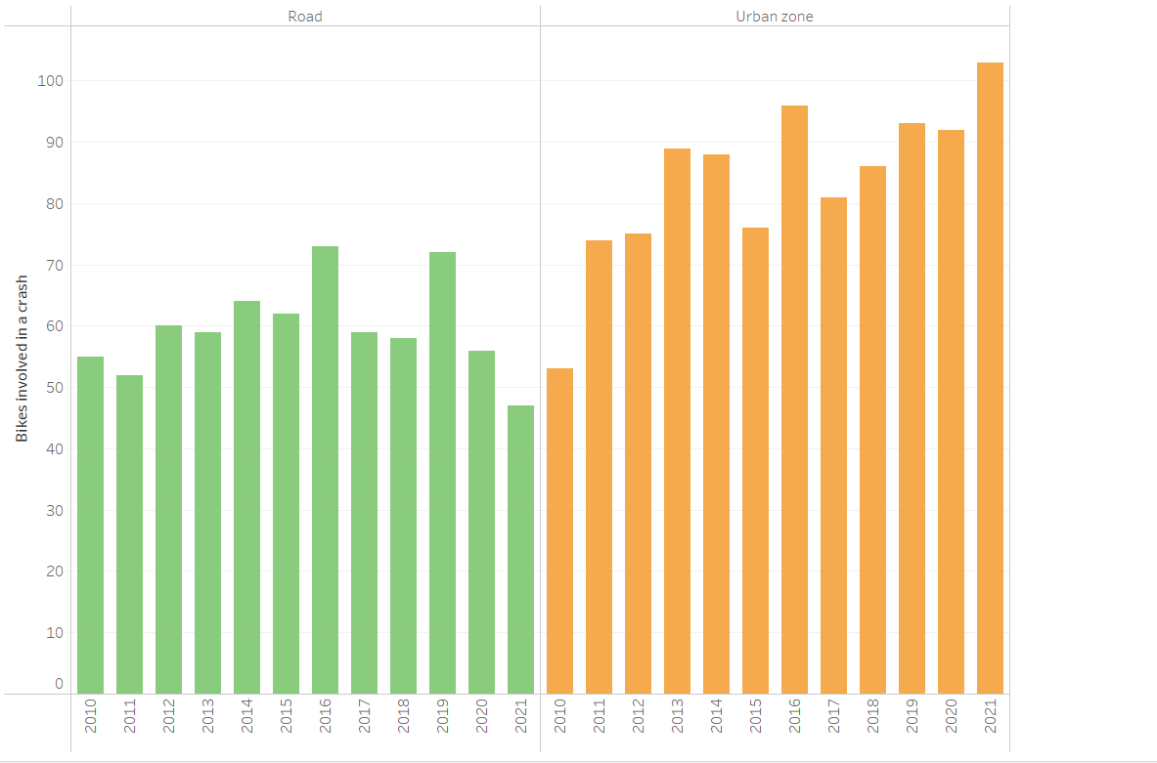
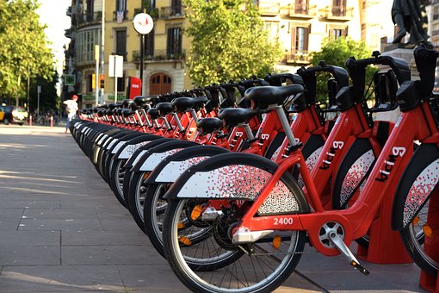


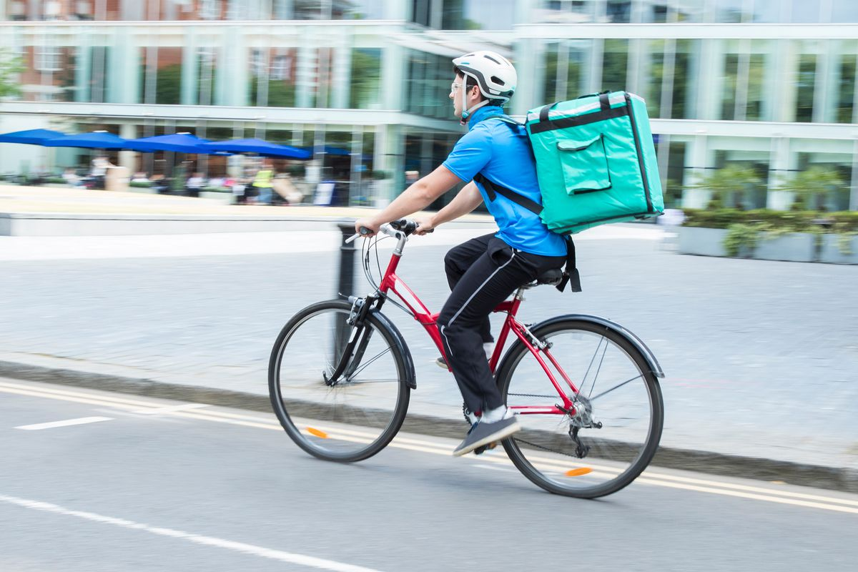
Accidents by year
Promoted a campaing to increase the usage of bikes in the cities.
Food deliveries with bikes.
More homework in rural areas helped to decrease traffic on road.
1 accident for each 6,1 days
1 accident for each 4,3 days
717
1.006

Slide 6
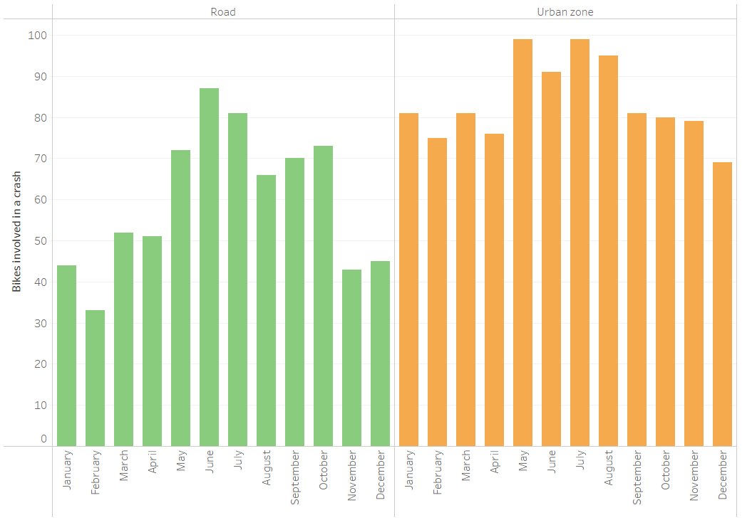
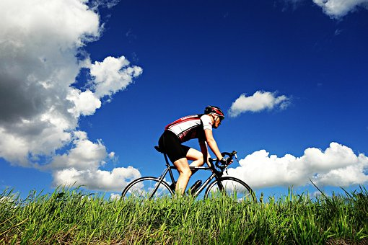
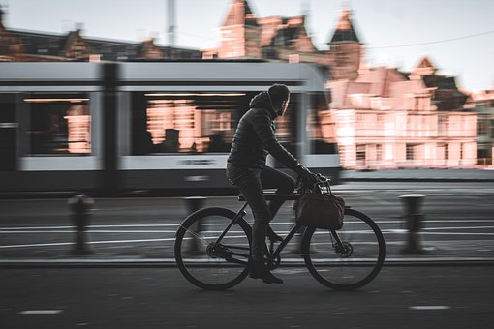
Accidents by month
Good weather for Cycling in route.
Bikes is a type of transport to go at work or at university in the cities.
Final Project – DA

Slide 7
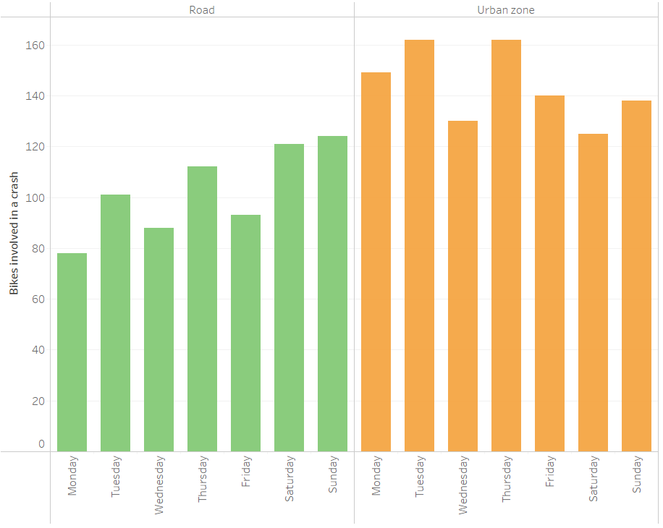
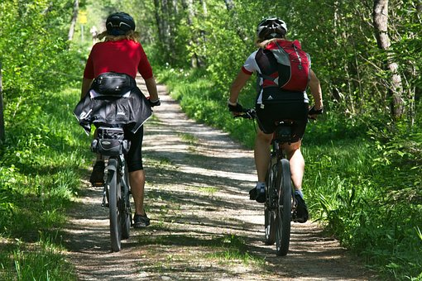

Accidents by weekday
Doing more sport during the weekend.
Stressful labourdays...
Final Project – DA

Slide 8
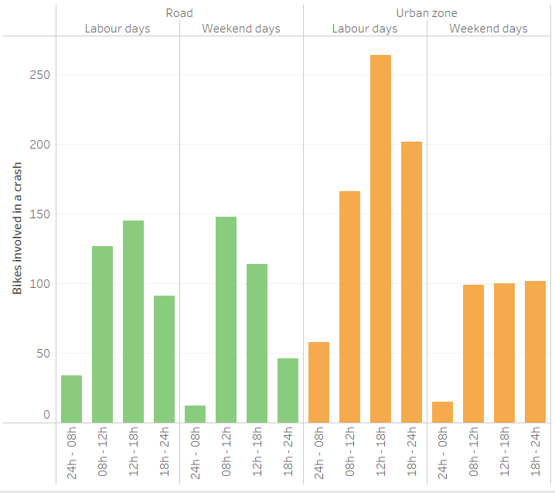

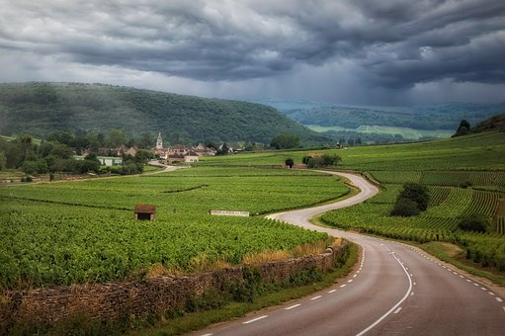
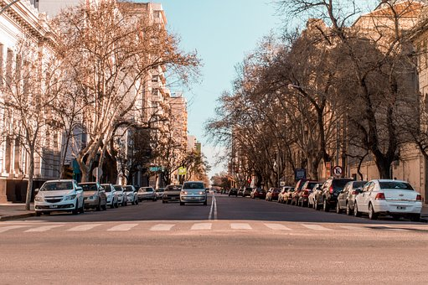
Accidents by hours
(labour days VS weekend)
Arriving at home after a long day of work
Same level of traffic congestion on weekend
Less stressful in the rural areas all the week.
Final Project – DA

Slide 9
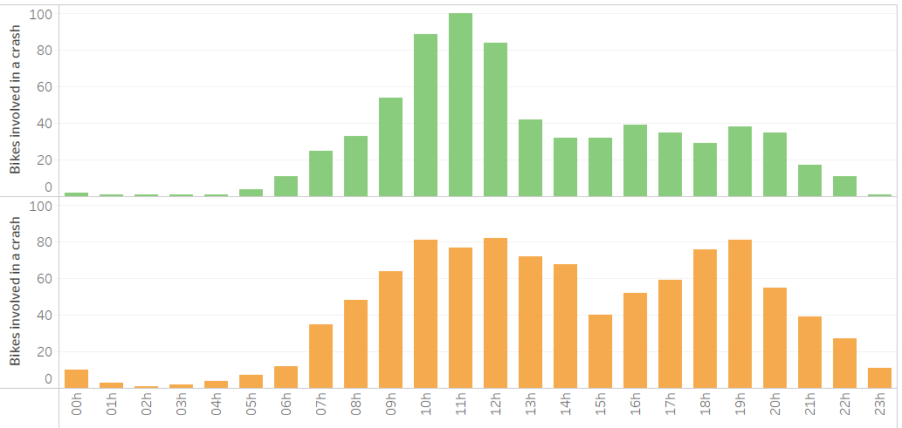
Accidents by hours
Same distribution in the morning hours
Lunch time
After work
Final Project – DA

Slide 10
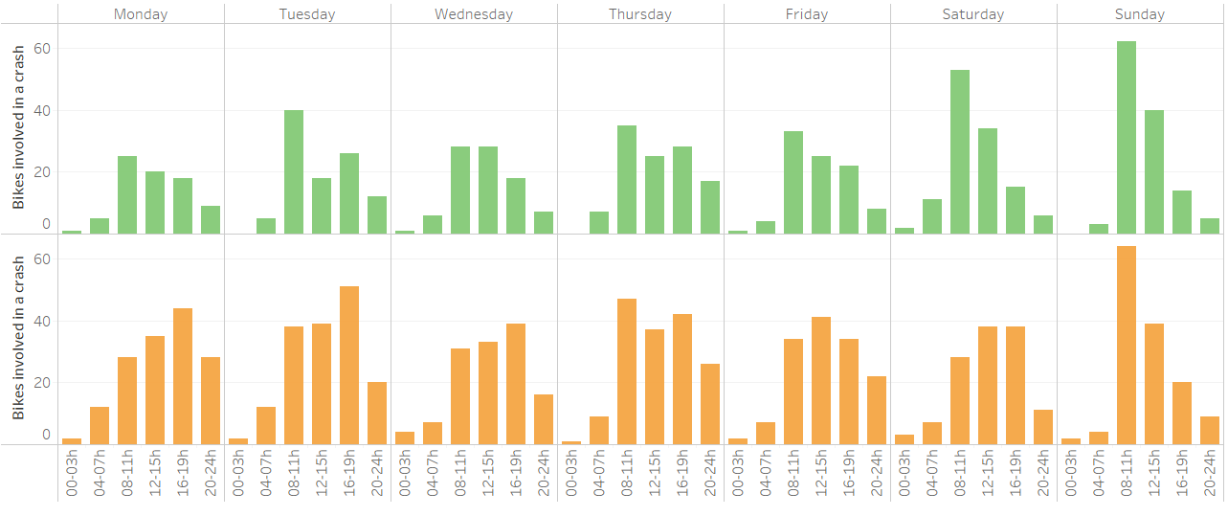
Accidents by hours and weekdays
Resting time but not in the urban zones
Sunday morning is the most favorite time to go cycling
Final Project – DA

Slide 11
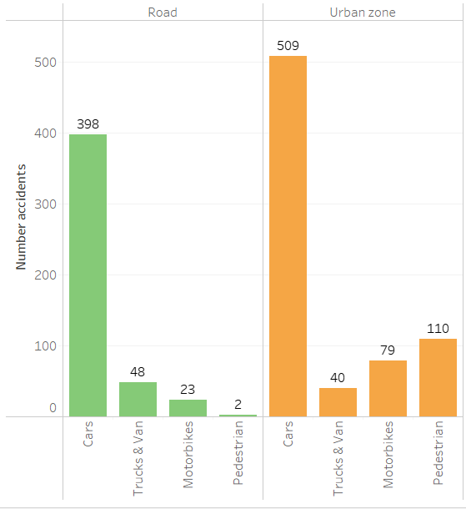
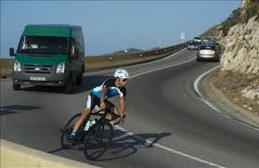

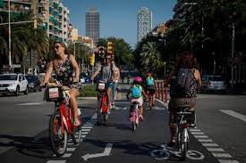
Accidents by type of vehicle
Cars need more space to overtake a clyclist.
Most of the times the drivers not respect the rules.
There are more types of obstacles for riders.
Final Project – DA

Slide 12
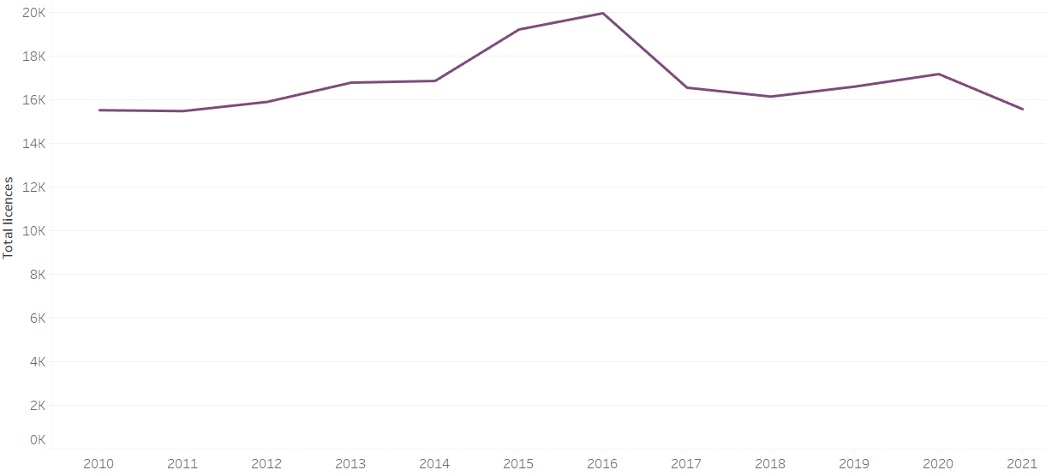
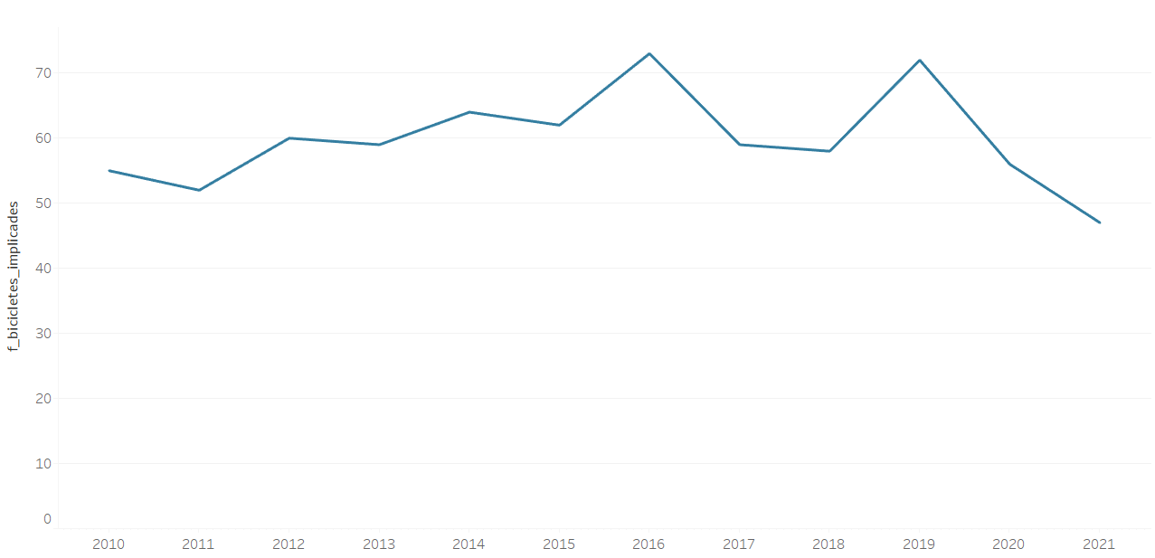
Number of licences per year
Number of accidents only on roads
Final Project – DA

Slide 13
Conclusion
Final Project – DA

Slide 14
Build more bikeways in the urban areas.
Avoid to do cycling on Sunday morning.
Try to do cycling in rural areas.
Missing data about speed in the data set.
Missing information about who particularly die when there is an accident
Conclusions
Final Project – DA

Slide 15
AI for saving cyclysts
Final Project – DA

Slide 16

Final Project – DA

Slide 17
Thank you!
Final Project – DA

